Slide 1

RevoU FSDA Assignment
➻
User Segmentation
Ecommerce Public Dataset
➻
Ecommerce Startup
by Yunianti Khotimah

Slide 2
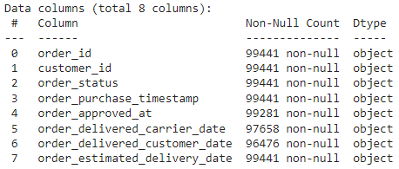
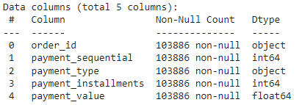
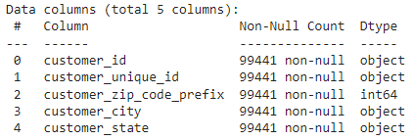
⋅ Dataset ⋅
⋅ Order ⋅
⋅ Customer ⋅
⋅ Payment ⋅

Slide 3
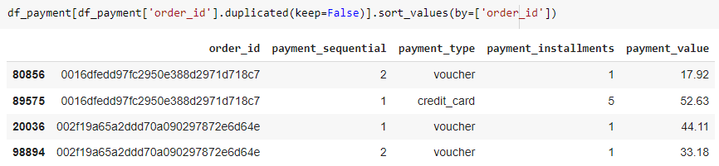
⋅ Data Cleaning ⋅
Drop missing values (date columns) → undelivered or unfinished order
Cross-field validation on date variables Customer purchase <= payment approved <= delivered by carrier <= delivered to customer
Check duplicate data → Handle duplicate order_id on Payment Dataset It happened when customer select multiple payment methods

Slide 4
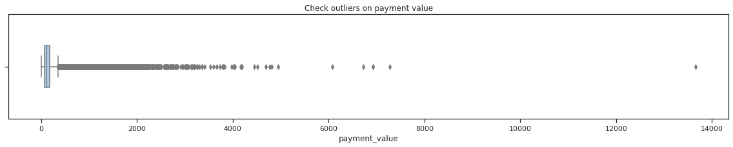
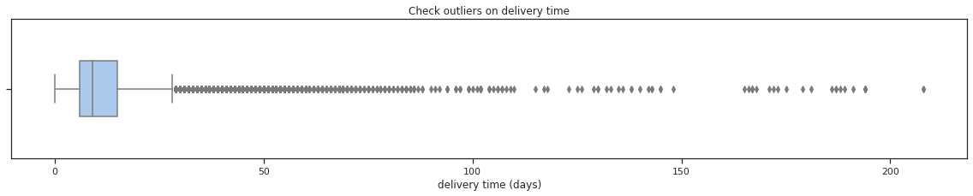
⋅ Data Cleaning ⋅
Check outliers on payment_value and actual_delivery_time Remove outliers using upper limit Q3+1.5*IQR
Drop irrelevant columns and merge all dataset into one data

Slide 5
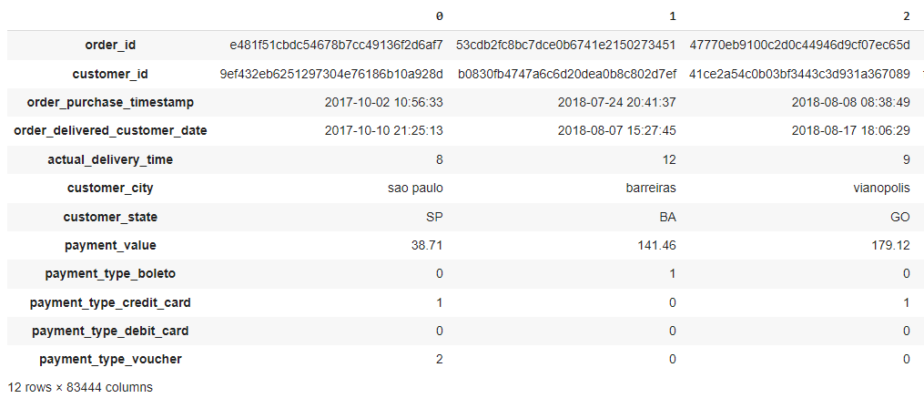
⋅ Data Cleaning Result ⋅
In a transposed view

Slide 6
Cluster Analysis 01

Slide 7
⋅ Objective 1 ⋅
Used Variables:
Payment value
Purchased day
Purchased hour time
All payment methods chosen by user (one hot encoding)
Clustering the user based on their purchase-payment behaviors and analyze the result (each cluster)

Slide 8
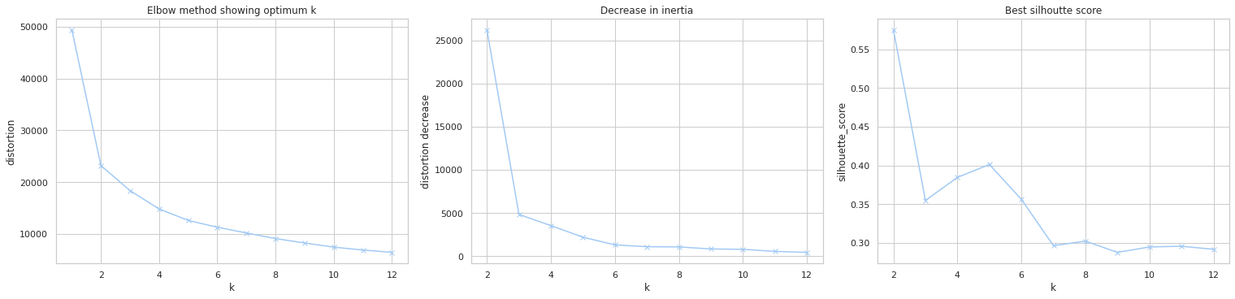
⋅ Optimum number of cluster ⋅
Decrease in inertia (distortion) begin to slow at k>=5
From silhouette score, for 3 <= k < 7 ⇒ k=5 is the best choice for 7 <= k < 12 ⇒ k=8 is the best choice

Slide 9
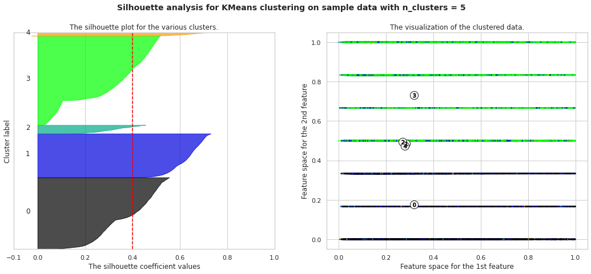
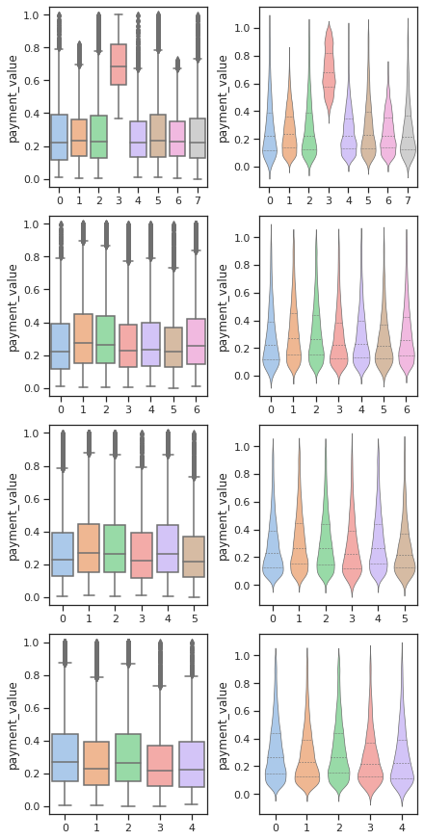
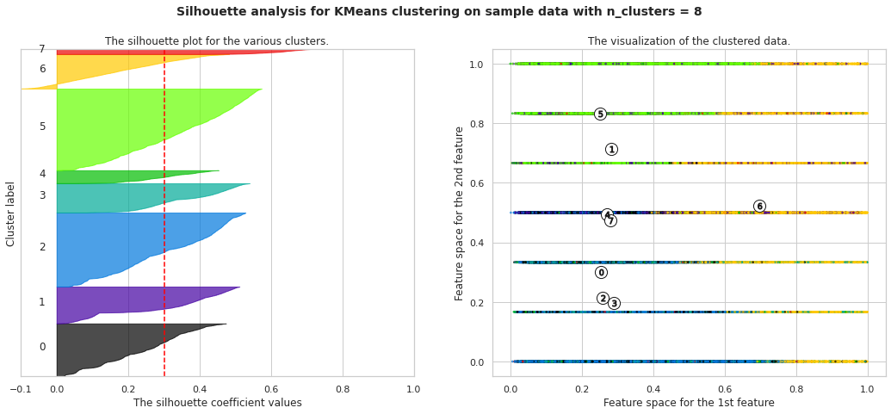
⋅ Optimum number of cluster ⋅
Among the variables used, payment value is the most meaningful one for business
For k=[5,6,7] the payment value is indistinguishable for each cluster
For k=8 there is distinguishable payment value
k = 8 is chosen as optimum number of cluster

Slide 10
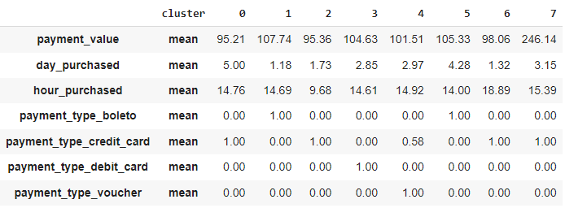
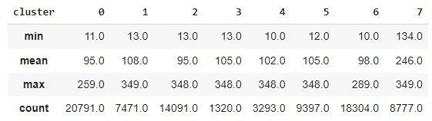
⋅ Cluster Result ⋅
Payment value description

Slide 11
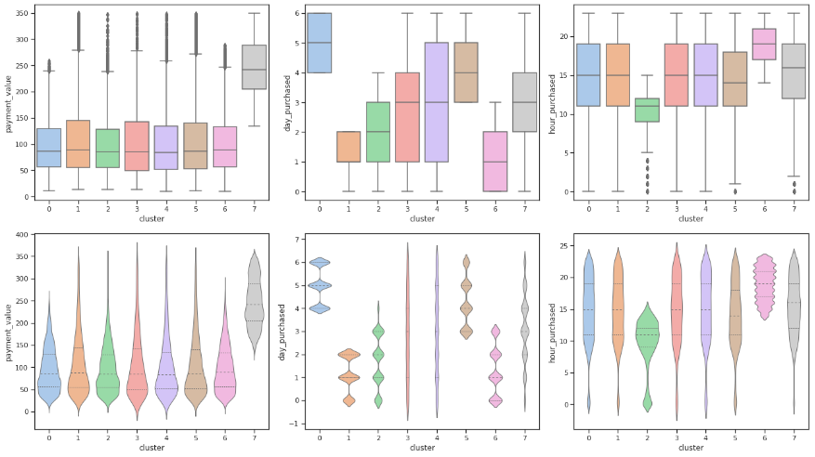
⋅ Cluster Result ⋅

Slide 12
⋅ Cluster Result ⋅

Slide 13
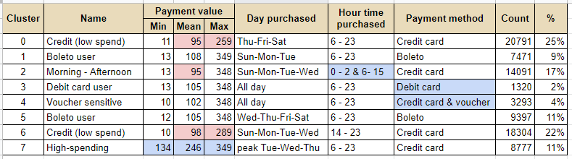
⋅ Cluster Summary - Insight ⋅
The clusters aren’t uniformly distributed

Slide 14
⋅ Cluster Summary - Insight ⋅
Cluster 7 (High-spending user) Avg spending 246 (min 134) mostly purchased on Tue-Wed-Thu using credit card (all)
Cluster 4 (Voucher sensitive user) Mostly they purchased using voucher, remaining payment using credit card
Cluster 2 (Morning-Afternoon people) They didn’t purchase above 3 pm and some do it in early morning (0-2 am)
Cluster 3 (Debit card user) Purchase using debit card
Cluster 1 & 5 (Boleto user) Purchase using boleto
Cluster 0 & 6 (Low-spending credit card user) Relatively low-spending with avg 95-98 (less than 259-289)

Slide 15
⋅ Recommendation ⋅
Special promotion targeting on the Top Spenders are better focused on Tuesday, Wednesday, Thursday (more effort on those 3 days)
It’s better focus on giving vouchers to Voucher-sensitive users to trigger them to checkout their shopping cart

Slide 16
Cluster Analysis 02

Slide 17
⋅ Objective 2 ⋅
Used Variables:
Delivery time (days)
Delivered day
Delivered hour time
State (user location)
Clustering the user based on the delivery-received time and location (state) and analyze the result (each cluster)

Slide 18
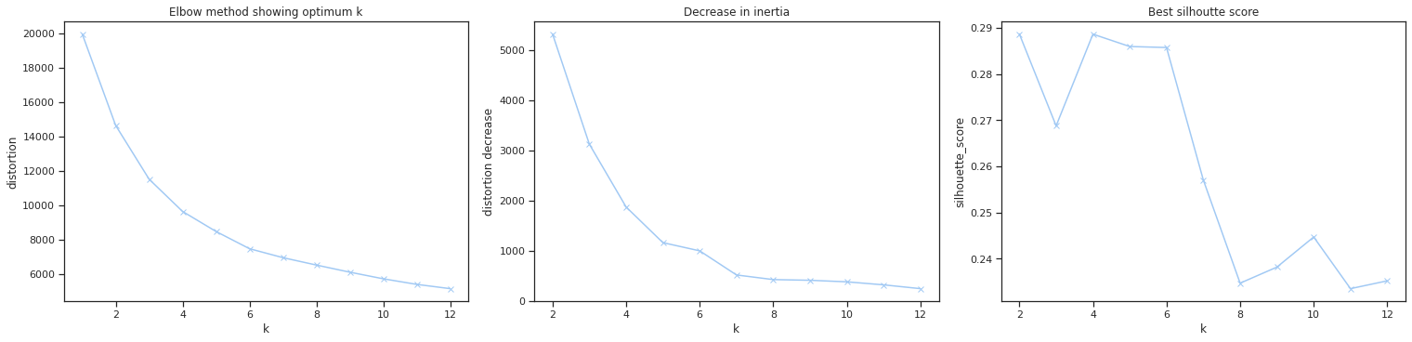
⋅ Optimum number of cluster ⋅
Decrease in inertia (distortion) begin to slow at k>=6
From silhouette score, k = [2, 4, 5, 6] show similar result (high score)

Slide 19
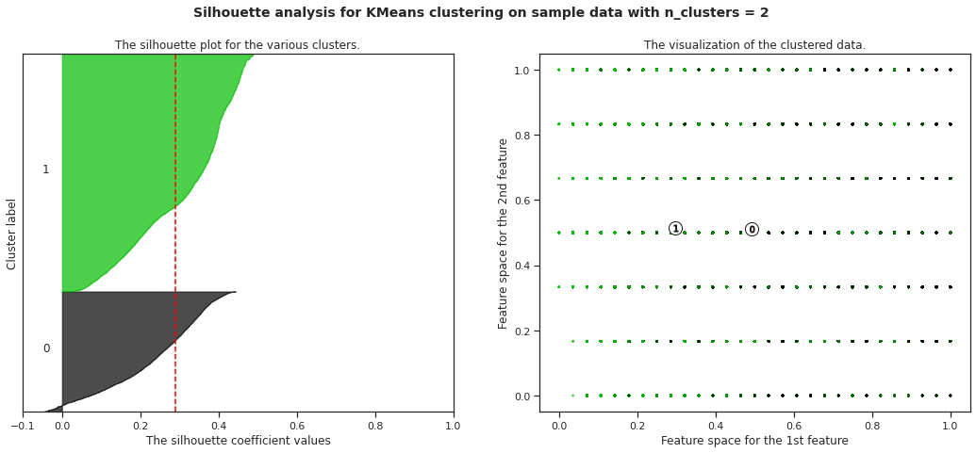
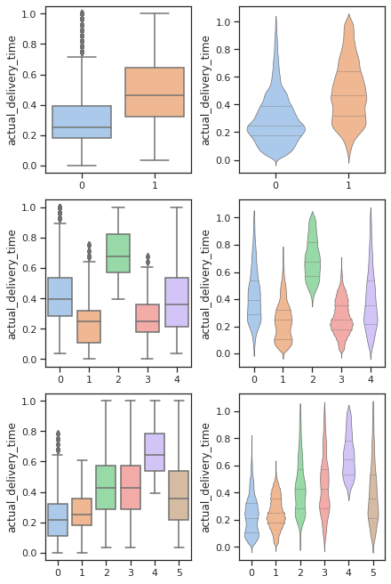
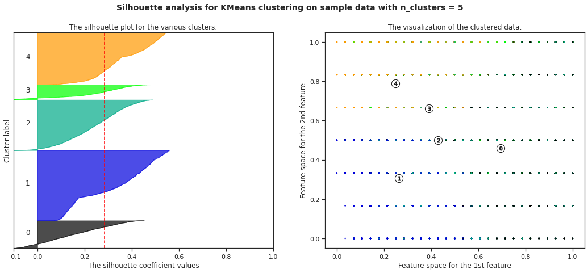
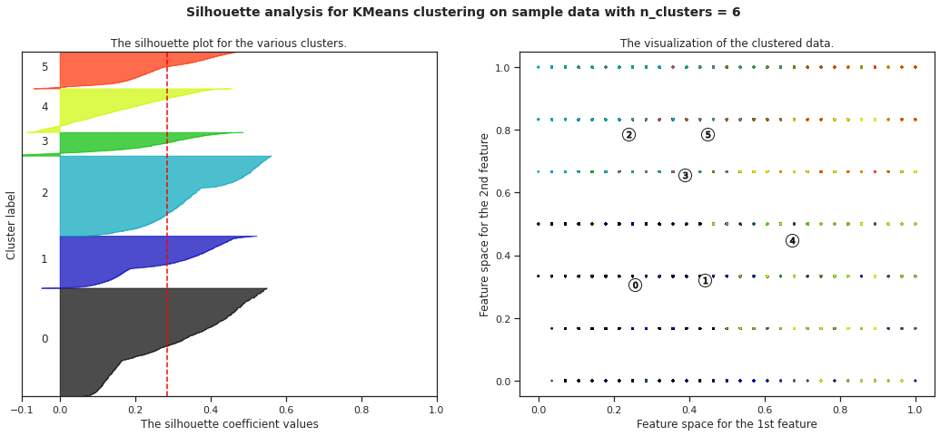
⋅ Optimum number of cluster ⋅
Among the variables used, delivery time is the most meaningful one
For k=2 the delivery time is faintly distinguishable
For k=[5,6] it’s stronger
k = 6 is chosen as optimum number of cluster

Slide 20
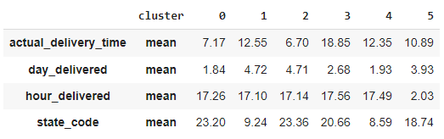
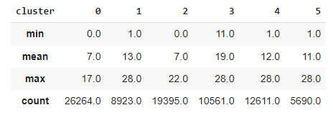
⋅ Cluster Result ⋅
Delivery time description

Slide 21
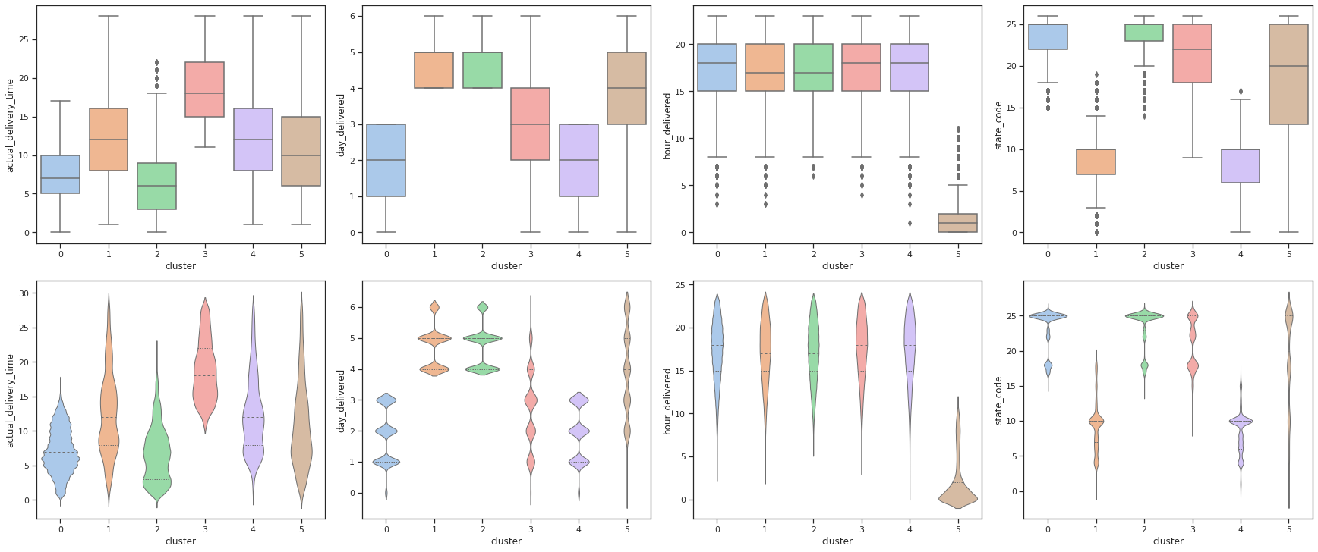
⋅ Cluster Result ⋅

Slide 22
⋅ Cluster Result ⋅

Slide 23
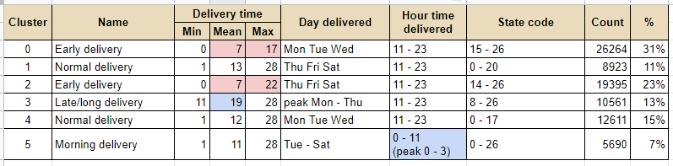
⋅ Cluster Summary - Insight ⋅
The clusters aren’t uniformly distributed

Slide 24
⋅ Cluster Summary - Insight ⋅
Cluster 3 (Late/long delivery) Avg takes 19 days (min 11 days), mostly happen on Mon-Thu in 19 States
Cluster 5 (Morning delivery) Mostly delivered on early morning (0-3 am) happen on Tue-Sat
Cluster 0 & 2 (Early delivery) Avg takes 7 days, happen on Mon-Sat in 13 States
Cluster 1 & 4 (Normal delivery) Avg takes 12-13 days, happen on Mon-Sat in 20 States

Slide 25
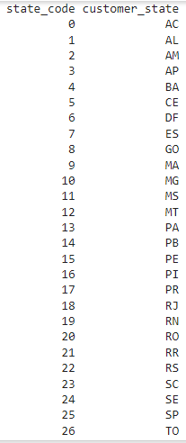
⋅ Cluster Summary - Insight ⋅
The delivery rarely happen on Sunday
State 0-7 High chance of normal delivery Low chance of early or late delivery
State 8-13 High chance of normal or late delivery Low chance of early delivery

Slide 26
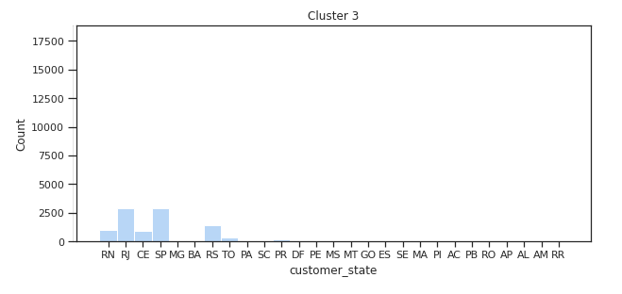
⋅ Recommendation ⋅
Delivery time = date delivered to customer - date approved payment
Assuming that the “date delivered” use confirmation system by user (received)
For late delivery cluster, build a push notification system for those users who forget to confirm that the package has been received Recommended time ⇒ Mon-Thu 11AM-11PM Priority state ⇒ state_code 8-26 or RJ, SP, RS, RN, CE, TO
Decoding state_code

Slide 27

Thank
You
➻
➻

